Slide 1
Quiz

Slide 2
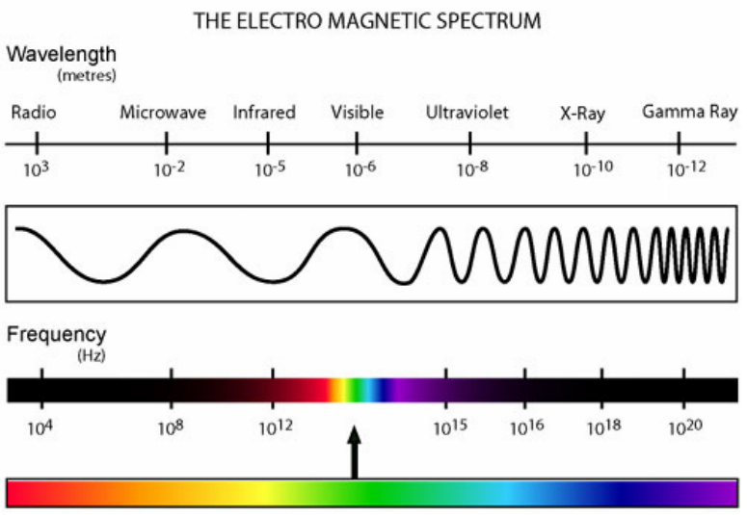
Microwaves are more dangerous forms of radiation than radio waves.

Slide 3
How are radiation and chemotherapy different?
Chemotherapy prevents DNA replication.
Radiation therapy kills the cancerous cell.

Slide 4
How are they similar?

Slide 5
Which of the following is NOT a property of cancer cells?
They have the ability to avoid cell death.
They have limitless reproductive potential.
They are better at fixing mistakes in DNA than normal cells.
Have the potential to obtain their own blood supply.
All of the above

